Slide 1
Major Assignment 3
Project budget and projection
funding

Slide 2
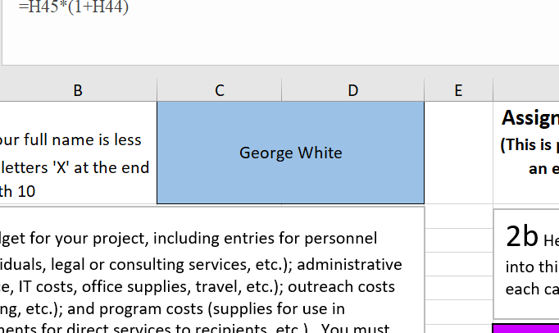
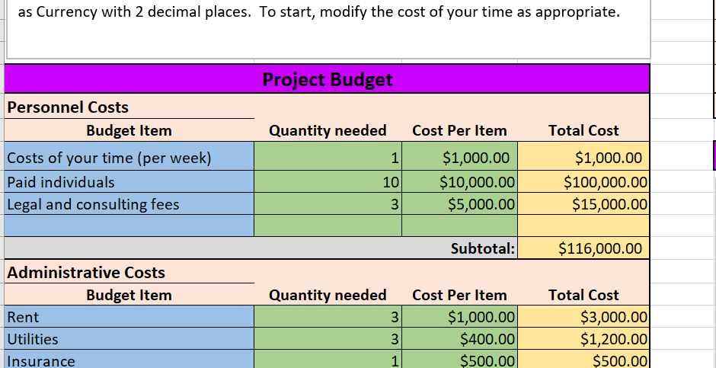
Project Budget and Projection
Once again, don’t forget to enter your name.
Don’t forget to use Excel formulas for the yellow cells (This is very similar to Major Assignment 1).

Slide 3
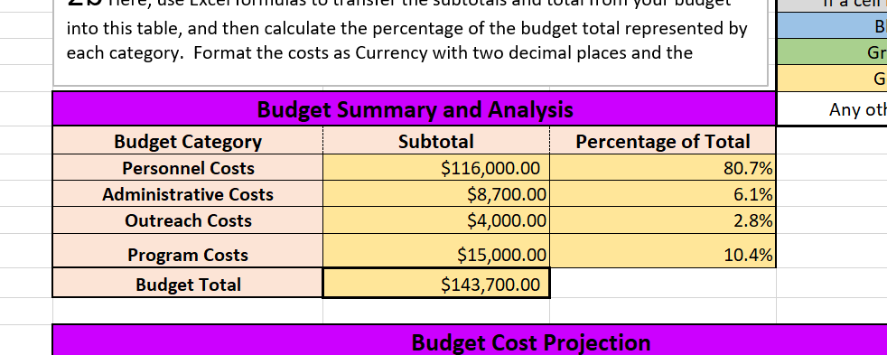
Project Budget and Projection
Once again, “Budget Summary and Analysis” is similar to Major Assignment 1.
You can find the explanations for the slope and intercept in the powerpoint for Major Assignment 1 (Sheet 4).

Slide 4
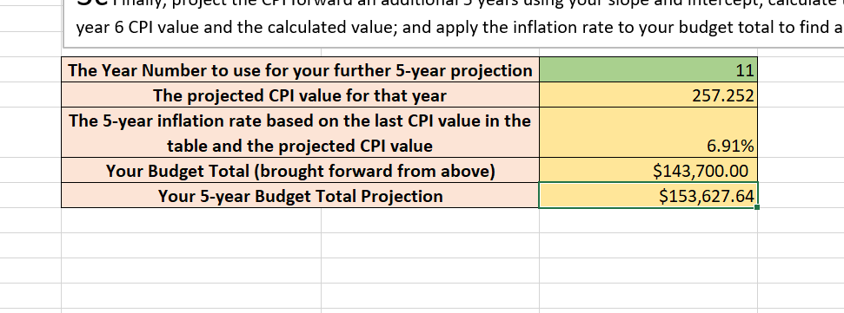
Project Budget and Projection
The projected CPI values is =slope * year + intercept.
The five-year inflation rate is =(The projected CPI – CPI in year 6)/CPI in year 6 (Don’t forget the parenthesis).
Your five-year budget total projection is =your current budget total * (1 + inflation rate).

Slide 5
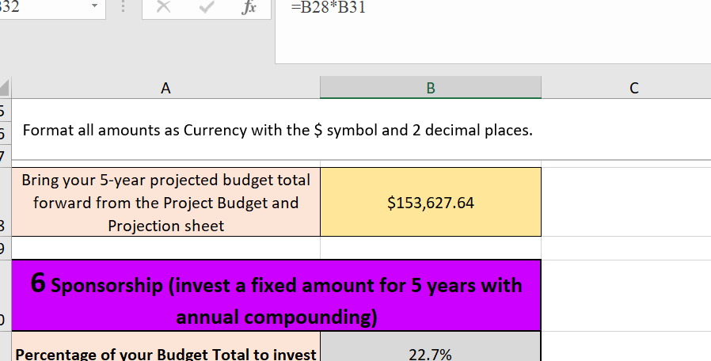
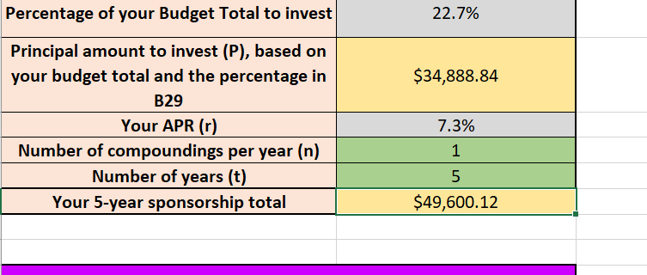
Funding
Once again, you need to copy and paste the formula from the previous sheet (Refer to the powerpoint for Major Assignment 2 – sheet 6).
The formula for “your 5-year sponsorship total” is =principal amount (P) * (1+APR/n)^(n*t).

Slide 6
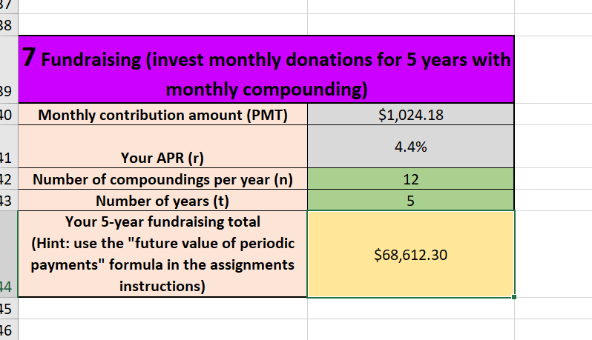
Funding
Regular payments formula (also called the future value of periodic payments formatted for EXCEL:
A = PMT * ((1 + r/n)^(n * t)-1)/(r/n).
A is the accrued amount after t years of making regular payments, PMT, into an account at interest rate, r %, compounded n times each year.

Slide 7
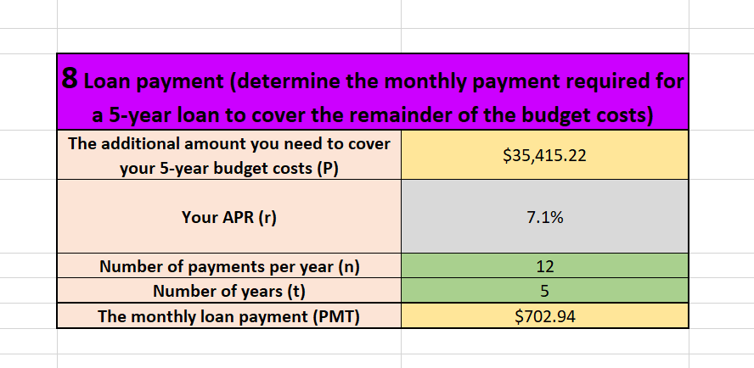
Funding
Use the formula that appears above this question for the monthly loan payment; i.e., use
PMT = P*(r/n)/(1 - (1 + r/n)^(-n*t))

